Slide 1




Information
Security

Slide 2
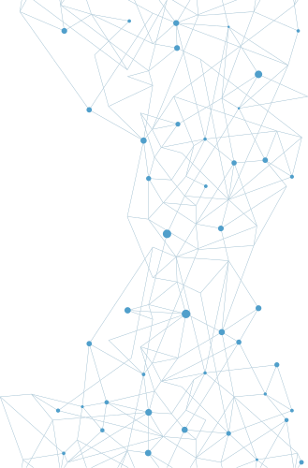
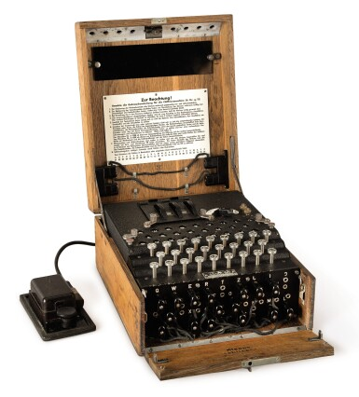
The History
of Information Security
The need for computer security arose during World War II when the first mainframe computers were developed and used to aid computations for communication code breaking messages from enemy cryptographic devices like the Enigma

Slide 3

The History
of Information Security
1960S
1970S
1980S
1990S
2000S
The Department of Defense’s Advanced Research Projects Agency (ARPA) began examining the feasibility of a redundant, networked communications system to support the military’s exchange of information.
TCP (the Transmission Control Protocol) and IP (the Internet Protocol) were developed and became the primary protocols for the ARPANET, eventually becoming the protocols we use on the Internet to this day.
Robert M. Metcalfe identified that individual remote sites did not have sufficient controls and safeguards to protect data from unauthorized remote users
The Internet was made available to the general public in the 1990s after decades of being the domain of government, academia, and dedicated industry professionals
The Internet brings millions of unsecured computer networks and billions of computer systems into continuous communication with each other.

Slide 4
What is
Security?
Security is protection. Protection from adversaries—those who would do harm, intentionally or otherwise—is the ultimate objective of security
Communications security. The protection of all communications media, technology, and content.
information security. Protection of the confidentiality, integrity, and availability of information assets, whether in storage, processing, or transmission, via the application of policy, education, training and awareness, and technology.
C.I.A. triad. The industry standard for computer security since the development of the mainframe. The standard is based on three characteristics that describe the utility of information: confidentiality, integrity, and availability.
Network security. A subset of communications security; the protection of voice and data networking components, connections, and content.
Security. A state of being secure and free from danger or harm. Also, the actions taken to make someone or something secure.

Slide 5
Key Information
Security Concepts
Access: A subject or object’s ability to use, manipulate, modify, or affect another subject or object.
Exploit: A technique used to compromise a system.
Exposure: A condition or state of being exposed; in information security, exposure exists when a vulnerability is known to an attacker.
Asset: The organizational resource that is being protected.
Attack: An intentional or unintentional act that can damage or otherwise compromise information and the systems that support it.
Loss: A single instance of an information asset suffering damage or destruction, unintended or unauthorized modification or disclosure, or denial of use.
Control, safeguard, or countermeasure: Security mechanisms, policies, or procedures that can successfully counter attacks, reduce risk, resolve vulnerabilities, and otherwise improve security within an organization.

Slide 6
Key Information
Security Concepts
Protection profile or security posture: The entire set of controls and safeguards, including policy, education, training and awareness, and technology, that the organization implements to protect the asset
Threat agent: The specific instance or a component of a threat.
Threat event: An occurrence of an event caused by a threat agent.
Risk: The probability of an unwanted occurrence, such as an adverse event or loss.
Threat source: A category of objects, people, or other entities that represents the origin of danger to an asset—in other words, a category of threat agents
Subjects and objects of attack: A computer can be either the subject of an attack—an agent entity used to conduct the attack—or the object of an attack: the target entity
Vulnerability: A potential weakness in an asset or its defensive control system(s).
Threat: Any event or circumstance that has the potential to adversely affect operations and assets.

Slide 7
Critical Characteristics
of Information
Accuracy. An attribute of information that describes how data is free of errors and has the value that the user expects.
integrity. An attribute of information that describes how data is whole, complete, and uncorrupted.
Authenticity. An attribute of information that describes how data is genuine or original rather than reproduced or fabricated.
Personally identifiable information (PII). A set of information that could uniquely identify an individual.
Availability. An attribute of information that describes how data is accessible and correctly formatted for use without interference or obstruction.
Possession. An attribute of information that describes how the data’s ownership or control is legitimate or authorized.
Confidentiality. An attribute of information that describes how data is protected from disclosure or exposure to unauthorized individuals or systems.
Utility. An attribute of information that describes how data has value or usefulness for an end purpose.

Slide 8
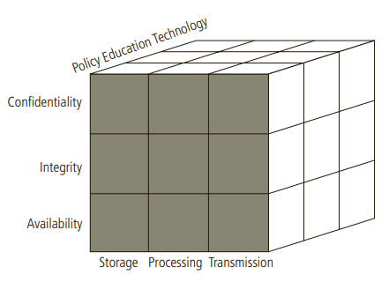
CNSS
Security Model
McCumber Cube. A graphical representation of the architectural approach widely used in computer and information security; commonly shown as a cube composed of 3x3x3 cells, similar to a Rubik’s Cube.

Slide 9
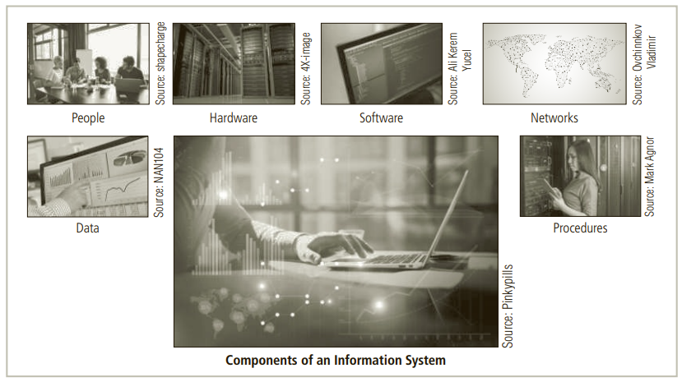
Components of
an Information System

Slide 10
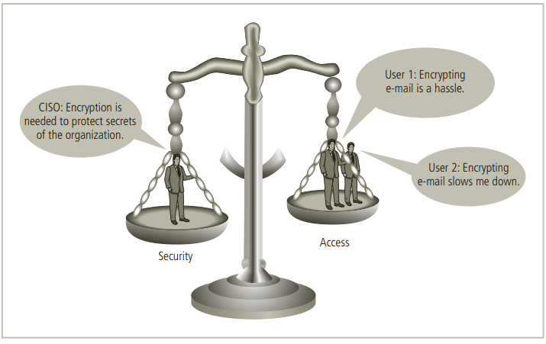
Balancing Information
Security and Access

Slide 11
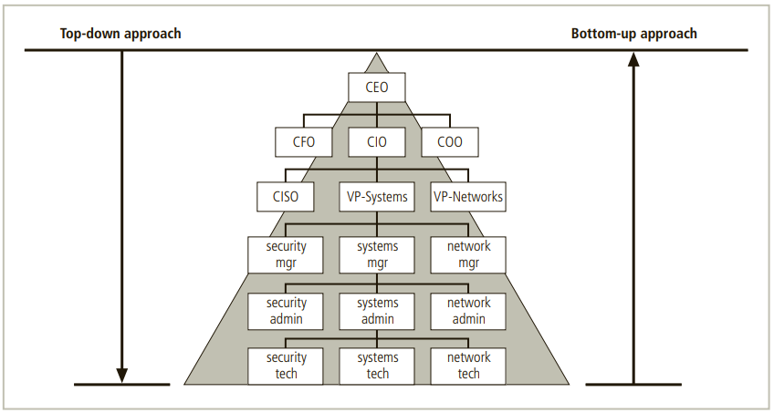
Approaches to Information
Security Implementation
Bottom-up approach. A method of establishing security policies and/or practices that begins as a grassroots effort in which systems administrators attempt to improve the security of their systems.
Top-down approach. A methodology of establishing security policies and/or practices that is initiated by upper management.

Slide 12
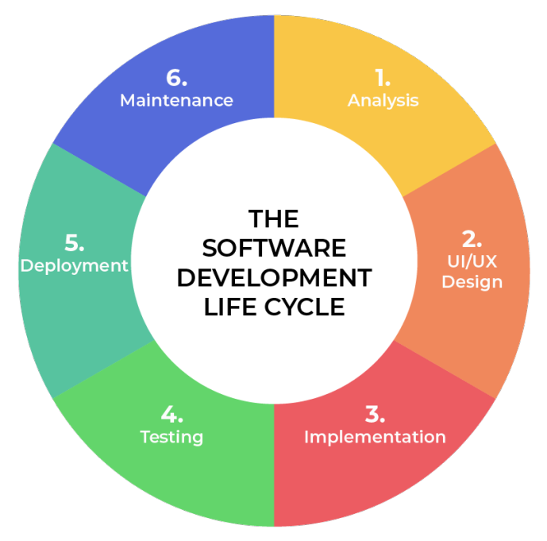
Security in the Systems
Development Life Cycle
Systems Development Life Cycle (SDLC). A methodology for the design and implementation of an information system. The SDLC contains different phases depending on the methodology deployed, but generally the phases address the investigation, analysis, design, implementation, and maintenance of an information system.
Methodology. A formal approach to solving a problem based on a structured sequence of procedures.

Slide 13
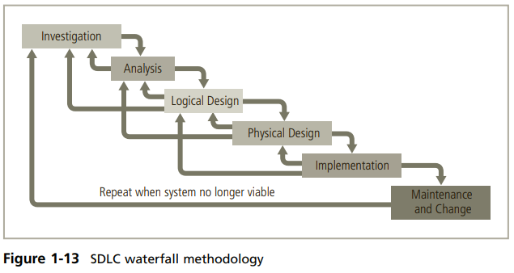
Traditional Development
Methods
Waterfall model. A type of SDLC in which each phase of the process “flows from” the information gained in the previous phase, with multiple opportunities to return to previous phases and make adjustments

Slide 14
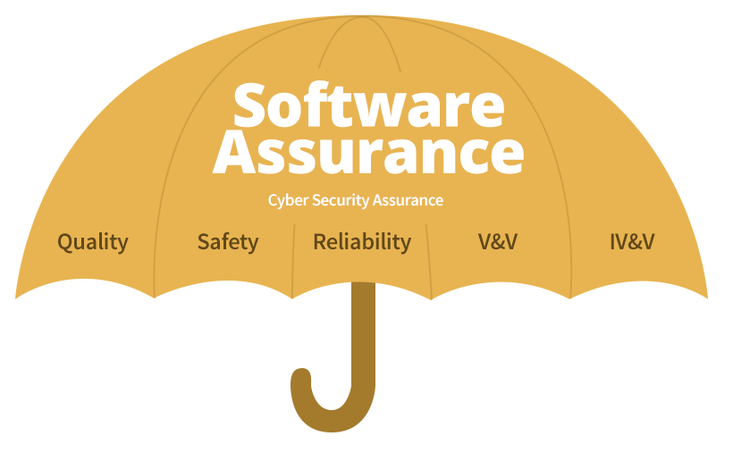
Software
Assurance
Software assurance (SA). A methodological approach to the development of software that seeks to build security into the development life cycle rather than address it at later stages. SA attempts to intentionally create software free of vulnerabilities and provide effective, efficient software that users can deploy with confidence.

Slide 15
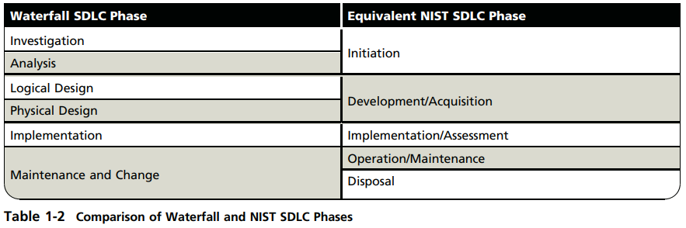
The NIST Approach
to Securing the SDLC

Slide 16
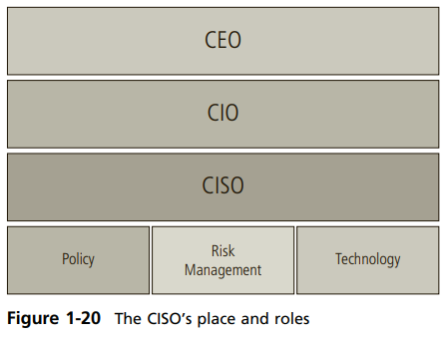
Security Professionals
and the Organization
SENIOR MANAGEMENT
Chief information officer (CIO). An executive-level position that oversees the organization’s computing technology and strives to create efficiency in the processing and access of the organization’s information.
Chief information security officer (CISO). Typically considered the top information security officer in an organization. The CISO is usually not an executive-level position, and frequently the person in this role reports to the CIO.

Slide 17
Security Professionals
and the Organization
INFORMATION SECURITY PROJECT TEAM
Project team. A small functional team of people who are experienced in one or multiple facets of the required technical and nontechnical areas for the project to which they are assigned.
ROLES:
Champion
Team leader
Security policy developers
Risk assessment specialists
Security professionals
Systems administrators
End users

Slide 18
Security Professionals
and the Organization
DATA RESPONSIBILITIES
Data custodians. Individuals who work directly with data owners and are responsible for storage, maintenance, and protection of information.
Data owners. Individuals who control, and are therefore responsible for, the security and use of a particular set of information; data owners may rely on custodians for the practical aspects of protecting their information, specifying which users are authorized to access it, but they are ultimately responsible for it.
Data users. Internal and external stakeholders (customers, suppliers, and employees) who interact with information in support of their organization’s planning and operations.

Slide 19
Communities
of Interest
Community of interest. A group of individuals who are united by similar interests or values within an organization and who share a common goal of helping the organization to meet its objectives.
Information Security Management and Professionals
Information Technology Management and Professionals
Organizational Management and Professionals
01
02
03

Slide 20
Thank
You

